Slide 1




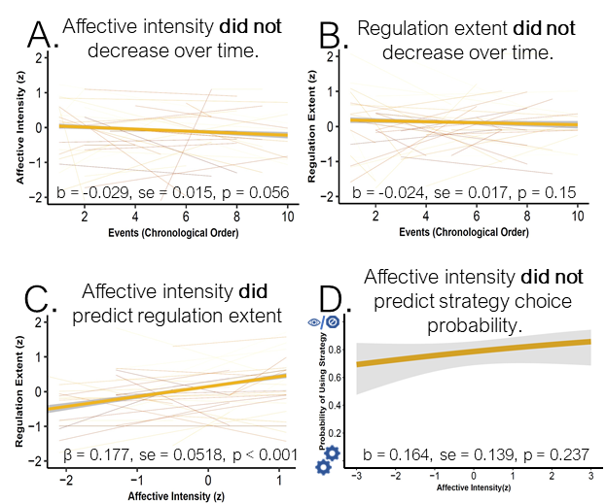






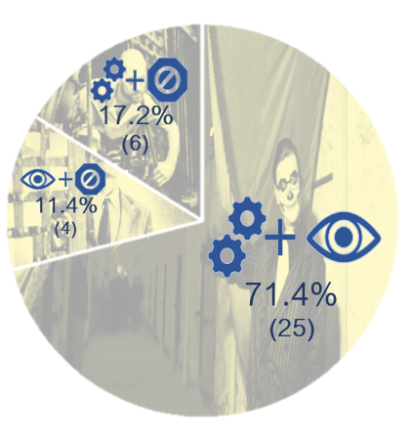
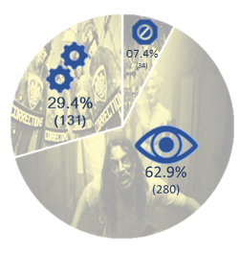


William Mitchell*, David Gregory,
Joanne Stasiak, Sam Reisman, Vishnu Murty, Chelsea Helion
Fear and Loathing in Eastern State Penitentiary Emotion Regulation in a Quasi-Naturalistic Setting
SAN LAB
*Contact: Billy.Mitchell@temple.edu
Background
Hypotheses
Analyses
Research suggests low intensity affective experiences prompt cognitive reappraisal strategies and high intensity experiences prompt disengagement techniques, such as distraction or suppression ¹⁻³.
However, lab studies and EMA studies may not reflect the nuances of emotion regulation choices in a strategy-naïve, real-world population.
Measuring affective responses in a controlled quasi-naturalistic environment using strategy-naïve participants may better approximate strategy selection in real-world circumstances.
Affective intensity will decrease over time.
Regulation extent will decrease over time.
Affective intensity will predict regulation extent.
As affective intensity increases, there is a greater probability of events being regulated via suppression or distraction, as opposed to reappraisal.
Events lacking categorical strategies or indications of downregulation were excluded (n_{obs.} = 1574), resulting in a dataset of 445 observations from 144 events.
35 events (24.3%) were categorized within two strategies. Analyses were performed including and excluding these events with no significant differences. Results presented represent the inclusion of multi-strategy events.
Hypotheses A, B, and C were tested using mixed effects linear regression modeling allowing intercepts to vary randomly by participant and, for Hypothesis C, treating time as a fixed effect (ICC_{A} = 0.286; ICC_{B&C} = 0.352) .
Hypothesis D was tested using mixed effects binary logistic regression specifying reappraisal (0) and disengagement strategies (1) as outcomes, adjusting for random intercepts of participant and treating time as a fixed effect (ICC_{D} = 0.620) .
Methods
Strategy Examples
54 participants progressed through a haunted house (x̄ _{exposure} = 55.20 mins.) in groups of 3 to 5 people.
After exposure, participants returned to the lab after a delay (x̄ = 5.98 days, sd = 0.79) to complete questionnaires noting 1.) ten emotionally-salient events, 2.) the emotions felt during each event, 3.) the intensity of each emotion, 4.) the extent to which it was regulated, and 5.) describing their regulation strategy.
Events were organized chronologically.
Participants were not trained in emotion regulation strategies prior to exposure.
13 participants were excluded from analyses for some form of missing data.
Two hypotheses-blind trained raters classified strategy descriptions into one or more strategy categories (IRR Agreement = 0.881).
Distraction
Results
“I focused on
my breathing;
looked down”
Reappraisal
Discussion
“I told myself
it wasn't real”
Our results suggest affective intensity predicts regulation extent, but fails to demonstrate predictive utility towards regulation strategy choice.
When resources are not strained, strategy selection may be better predicted by personal differences, like expectations, goals, and preferences, than fit⁴.
Limitations include a limited intensity range, end-point measurement of affective processing, and preponderance of multi-strategy events.
Future analyses will attempt to identify individual difference measurements which might better predict strategy choice in naturalistic settings.
Suppression
Multi - Strategy Frequency
“I just tried to calm down”
Strategy Frequency
Sample
References
Millgram, Y., Sheppes, G., Kalokerinos, E. K., Kuppens, P., & Tamir, M. (2019). Do the ends dictate the means in emotion regulation? J. Exp. Psychol. Gen., 148(1), 80–96.
Shafir, R., Thiruchselvam, R., Suri, G., Gross, J. J., & Sheppes, G. (2016). Neural processing of emotional-intensity predicts emotion regulation choice. Social Cog. Affect. Neurosci., 11(12), 1863–1871.
Sheppes, G., Scheibe, S., Suri, G., & Gross, J. J. (2011). Emotion-Regulation Choice. Psychol. Sci., 22(11), 1391–1396.
Ilan, S.D., Tamuz, N., & Sheppes, G. (2019). The fit between emotion regulation choice and individual resources is associated with adaptive functioning among young children. Cog. Emotion, 33(3), 597–605.
Interpreting Plots: Ribbons enveloping regression lines in A,B,C,D represent ±1 sd • Thinner regression lines in A,B,C represent the observed relationship between variables within individual participants • Thicker regression lines in A,B,C represent predicted variable relationships based on group observations • A value of 0 or 1 on D’s Y-axis represents either reappraisal or disengagement strategies, respectively, as the only predicted choice at that intensity level.
Notes:
Studies suggest that affective intensity predicts the strategies that people choose when trying to regulate their emotions.
More specifically, low intensity experiences tend to be regulated more often using reappraisal strategies and high intensity events tend to be regulated more often using disengagement strategies like distraction and suppression.
But often times participants are trained and prompted to regulate in a lab and It’s unclear whether this relationship holds up in a strategy naïve population
To test this, fifty- four participants were recruited for a study on memory and fear and asked to traverse a haunted house in Philadelphia
These participants completed a battery of assessments throughout the study,
but relevant to our analyses, after exposure they were asked to identify ten events from the haunted house that were emotionally salient to them.
These events which put in chronological order
For each event we asked them to identify the emotions they’d felt, the intensity of those emotions, the extent to which they tried to regulate those emotions, and to describe how they attempted to regulate them.
Two trained hypothesis blind raters then reviewed these responses and categorized them by strategy, as either reappraisal, distraction, suppression, a combination, or none of the above.
I found the strategy frequencies to be really interesting.
You can see on our left pie chart that distraction was by far the most popular,
being reported twice as often as reappraisal
and nearly 9 times as often as suppression.
After these strategies were categorized we reviewed our dataset
And we excluded a number of observations which were outside of the scope of this study.
More Specifically, we cut observations where participants reported not attempting to regulate their emotions, not using one or more the identified strategies, or cases where they attempted to upregulate, rather than downregulate their emotions.
So we’re looking at a narrow slice of affective experience here,
but something that approximates what we see in the lab studies without the explicit instructions that usually accompany them
This left us with a dataset of 445 observations from 41 participants and 144 events.
24.3% of events were categorized as having used multiple strategies. We’d ran our Analyses including and excluding these events with no significant differences in outcome.
All of these analyses include multi-strategy events with each strategy constituting a separate observation.
We have a quick breakdown of the reported multi-strategy pairings right here.
At the outset we theorized that individuals would habituate to their environment.
As such, affective intensity would decrease over time and that this would consequentially result in a reduction of regulation extent as well.
We also predicted that affective intensity would positively predict regulation extent,
and that low intensity affective experiences would be more likely to be regulated via reappraisal,
while high intensity events would be more likely to be regulated via disengagement strategies like distraction or suppression.
Using mixed effects linear regression, we found that affective intensity did not reduce significantly over time.
While this is counter to our hypothesis, it’s not really surprising.
These are professionals in a world renowned haunted house
If they weren’t good at keeping people on their toes, they likely wouldn’t stay open very long.
You might notice that the relationship is marginally significant.
Even so, I just want to point out the effect size is rather small.
Just to demonstrate, our mean intensity score was 5.6 on a 7 point scale, so if you gave that rating at event 1, this model predicts that at event 10, your rating would be a 5.4.
Likewise, we found no relationship between time and regulation extent.
We did find a notable effect of affective intensity upon regulation extent
such that a one standard deviation increase in affective intensity (or 1.3 pts) predicted a nearly 0.2 standard deviation increase in regulation extent (or about .3 pts).
To me this is a good a sanity check providing evidence that we are measuring the phenomena that we think we are.
But, no relationship was observed in a mixed effects binary logistic regression between regulation intensity and strategy choice.
So, even though we can somewhat reliably predict regulation even outside of the lab with untrained individuals
we can’t exactly predict what form that regulation will take
It’s of note that individual differences accounted for a high degree of the variance in all of these models, ranging from 28.6% of the variance in affective intensity, to 62% of the variance in strategy choice
It’s also of note that we did have a skewed distribution in affective intensity, with the mean being 5.6 and standard deviation being 1.3.
It may be the case that there were not enough low intensity affective experiences to properly demonstrate the relationship.
However, I do think the preponderance of multi-strategy events and cases of reappraisal observed even in such a positively skewed sample suggests regulation choices is far messier than binary decisions.
In terms of future analyses I imagine we will try to identify this mix of individual differences, possibly through goals, preferences, and expectations, to better predict strategy choice at the behavioral level of affective processing.
Together These results lend credence to the notion that strategy choice outside of a lab setting is a very complicated computation which likely won’t be explained by situation alone

Slide 2
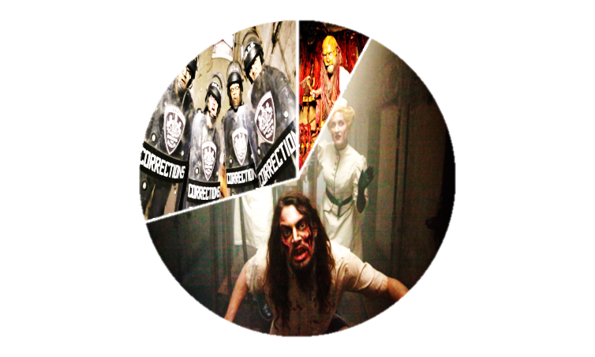
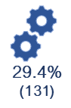

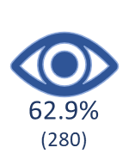
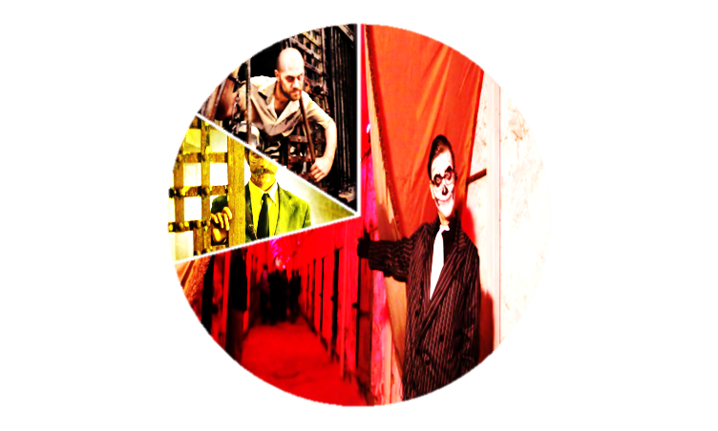
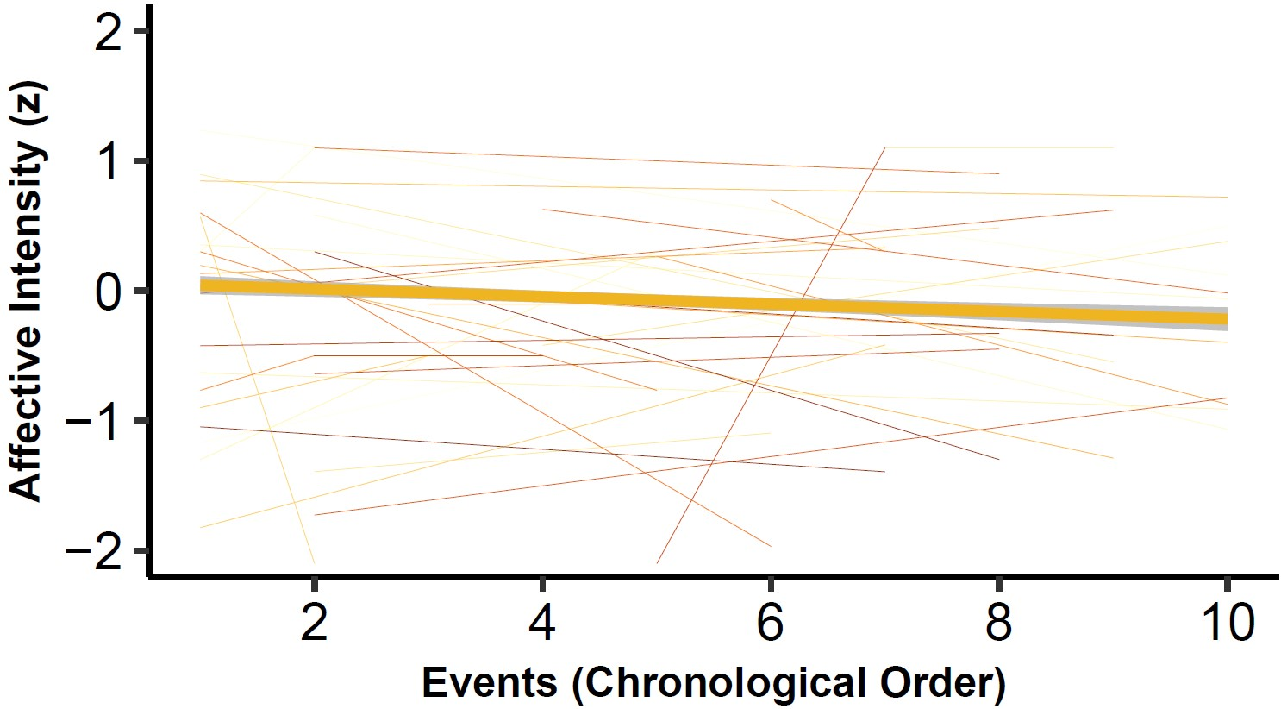
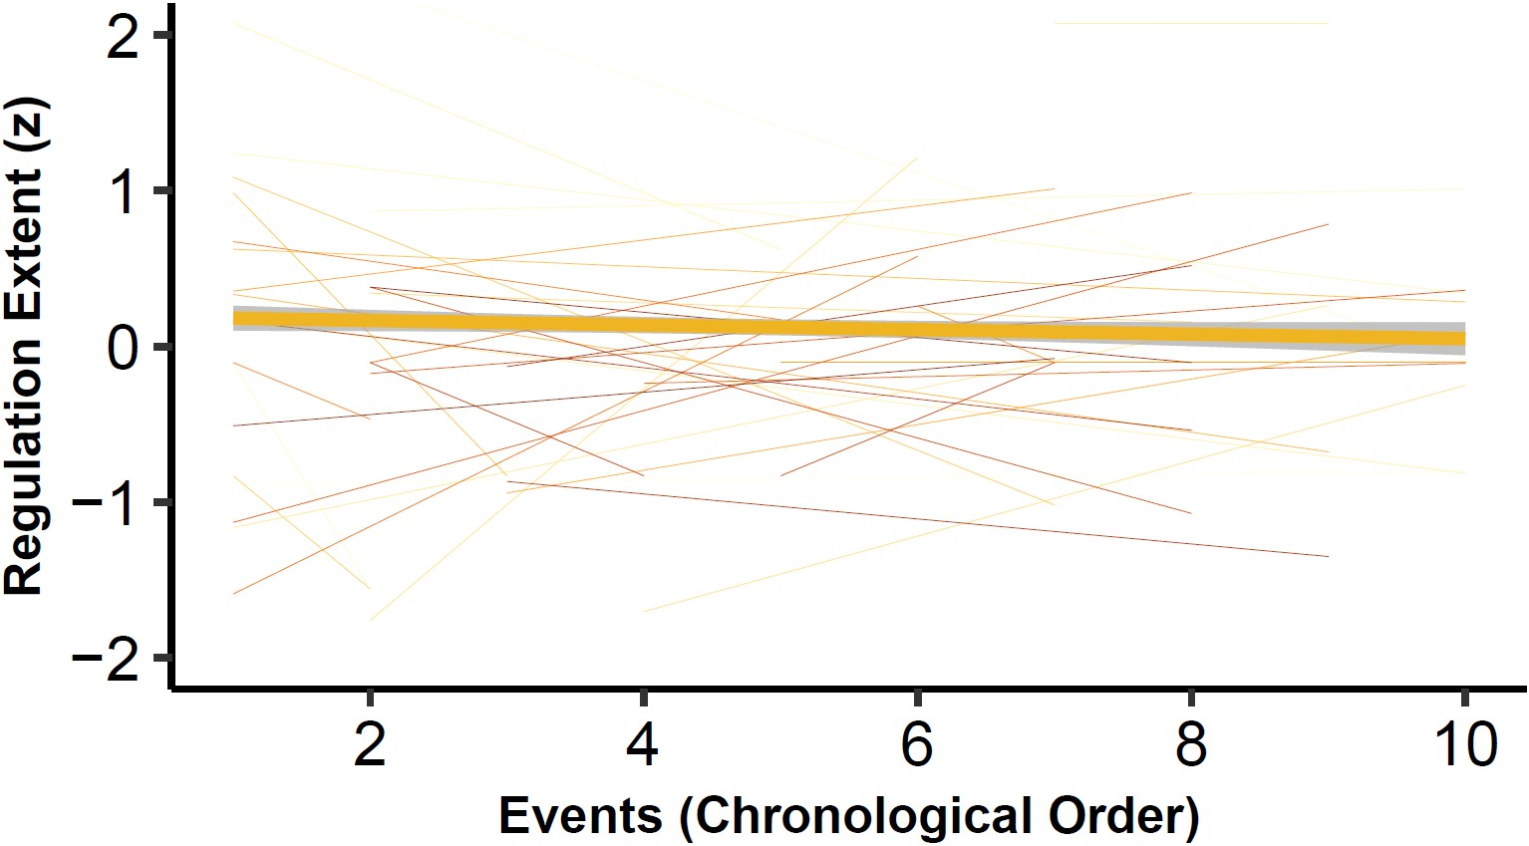
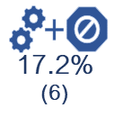
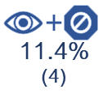
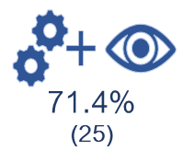
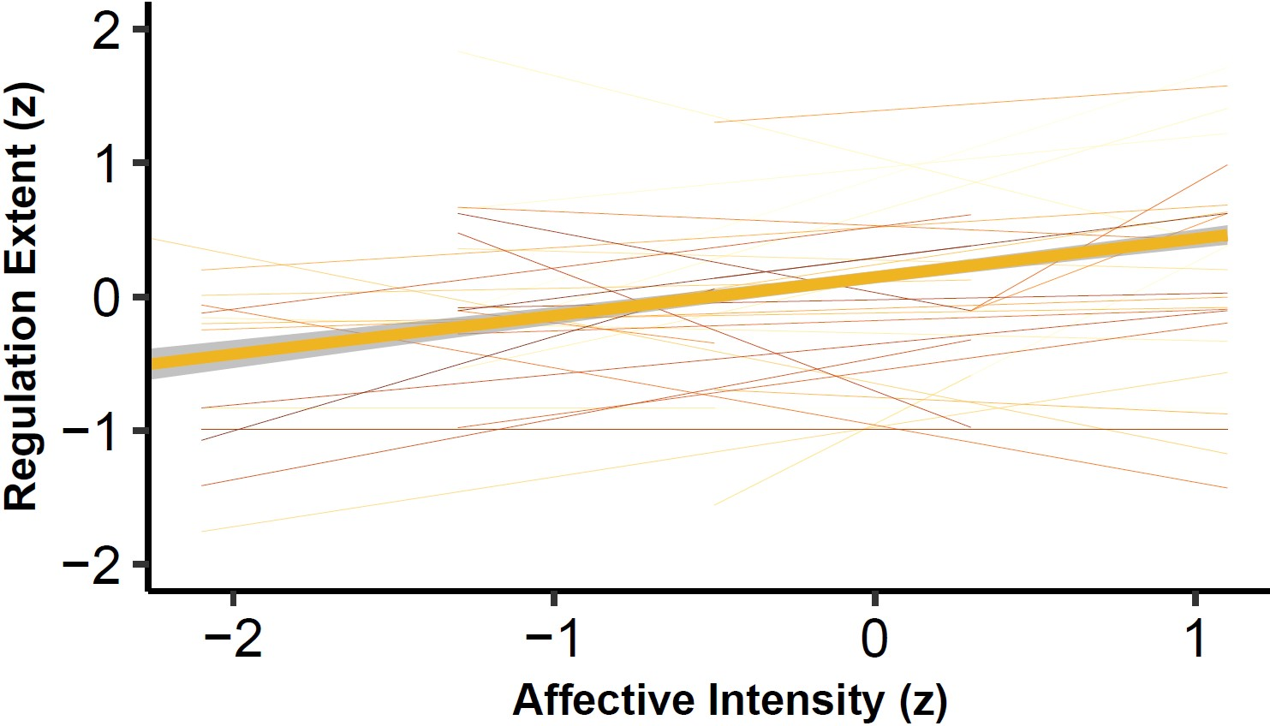


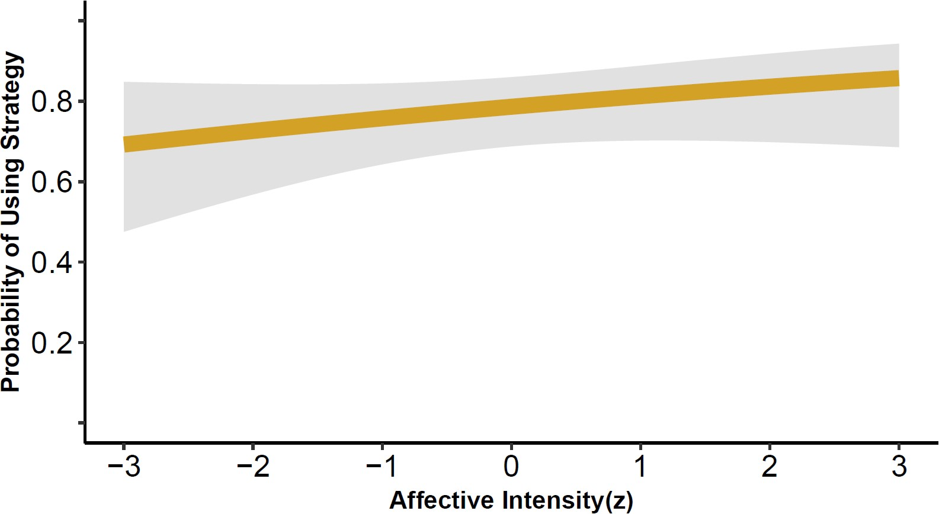

07.4%
(34)
Strategy Examples
Distraction
“I focused on
my breathing;
looked down”
Reappraisal
“I told myself
it wasn't real”
Suppression
“I just tried to calm down”
A.
Affective intensity did not
decrease over time.
B.
Regulation extent did not
decrease over time.
b = -0.029, se = 0.015, p = 0.056
b = -0.024, se = 0.017, p = 0.15
C.
Affective intensity did
predict regulation extent
D.
Affective intensity did not
predict strategy choice
probability.
β = 0.177, se = 0.0518, p < 0.001
b = 0.164, se = 0.139, p = 0.237

